Slide 1
BLOCKCHAIN USE CASES
Group Assignment - 1
Group - 3 :
Ajay Bachina
Ahmed Gaziyani
Nachiket Dharmik
Mayur R S
Suyog Katekar

Slide 2
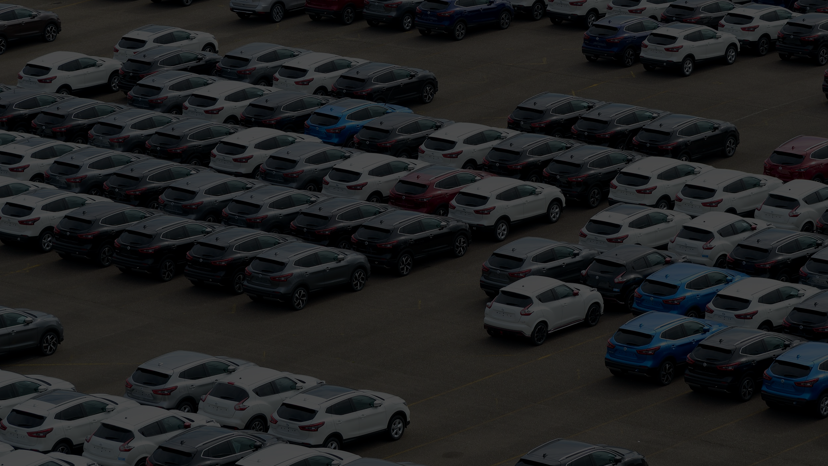
USE CASE - 1 :
Blockchain
in
Used Vehicle Market

Slide 3
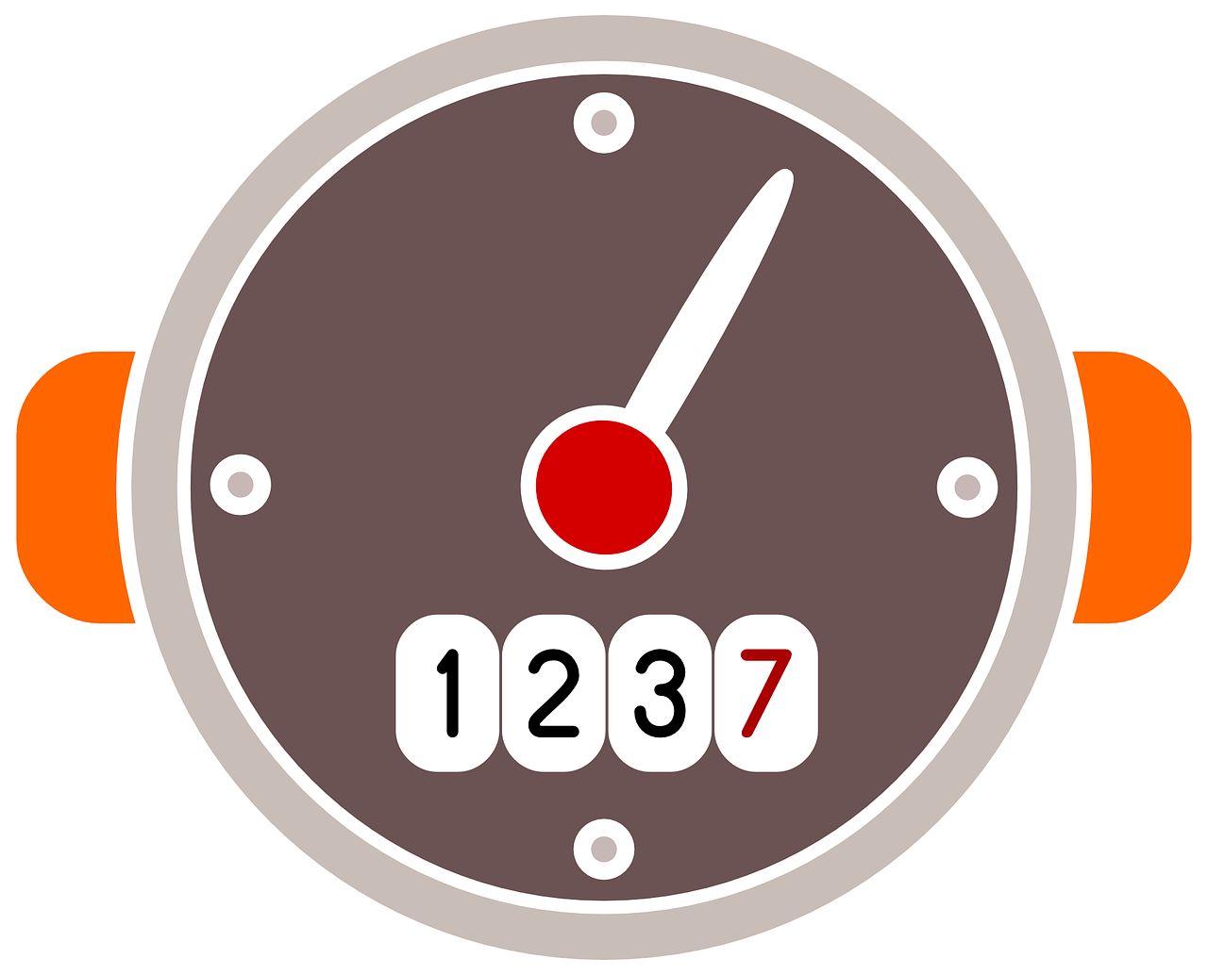
Major Problems in buying used vehicles :
Meter Tampering
Engine Damages
Repainted
Accident history

Slide 4

Solution :
Vehicle’s Odometer reading, Engine Failures, Part replacement, Vehicle’s Technical status can be stored in a Public Blockchain
These can be done by Authorized Service centers.
The Buyer can verify theses details on the blockchain before purchasing the vehicle.

Slide 5

USE CASE - 2 :
Private Blockchain
in
Enterprise Password Management

Slide 6
The Problem :
In a company individual employee has to manage multiple passwords across multiple accounts/websites.
It is very difficult for an employee to manage all the passwords, most of them will keep same passwords for all the accounts/websites or they store passwords in local machine in an Excel sheet or store in unencrypted format in Google drive, these are the serious security concerns.

Slide 7
Solution :
Private Blockchain can be used inside a company where the employees can store their encrypted passwords
Only the respective employee can decrypt and use the passwords when needed, in this way employees passwords will be safe and distributed within the company.

